Slide 1
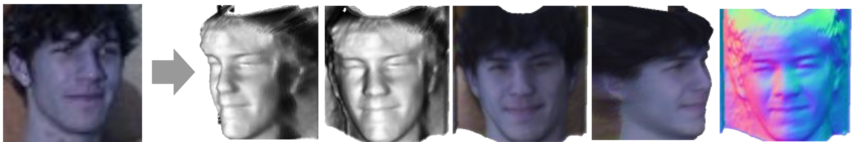




Toward Realistic Single-View 3D Object Reconstruction with Unsupervised Learning from Multiple Images
Long-Nhat Ho Anh Tuan Tran^{1,2} Quynh Phung¹ Minh Hoai^{1,3} VinAI Research¹ VinUniversity² Stony Brook Univeristy³
Notes:
Introduce

Slide 2

Motivation

Slide 3
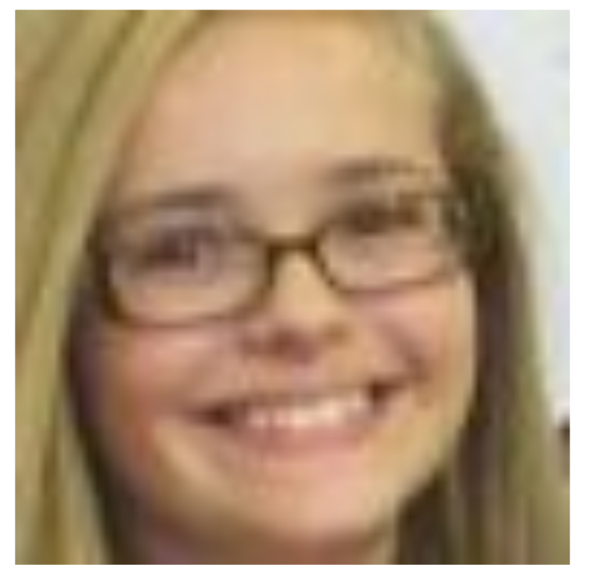
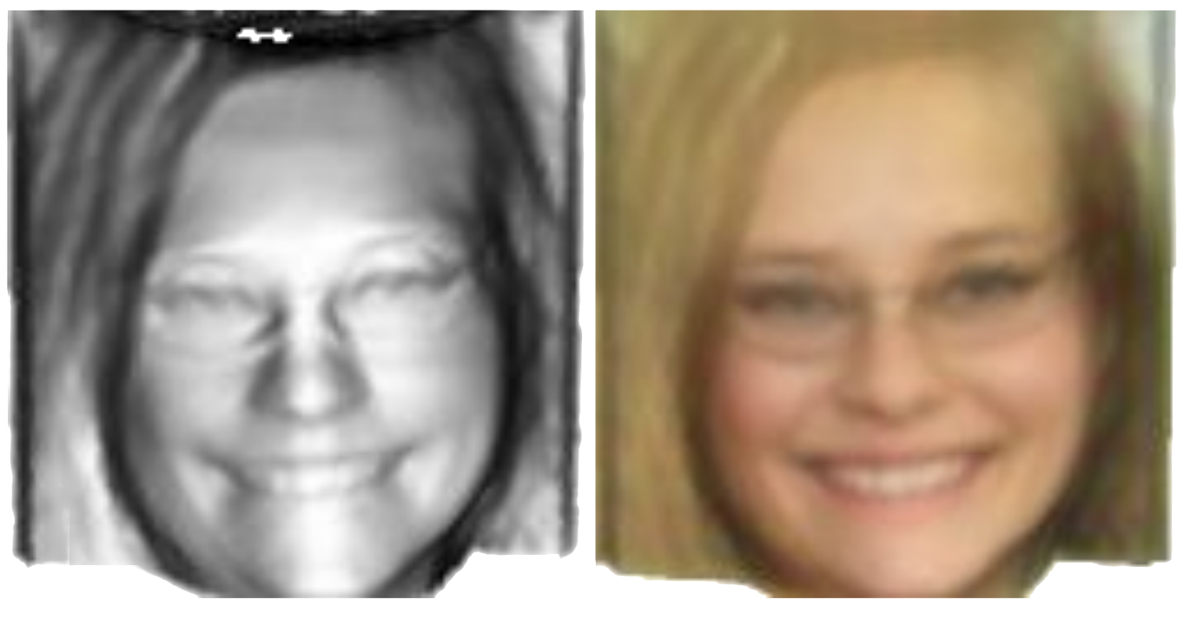
Problem
Recover 3D structure (shape + texture) of an object of a known category in a single image
✗ Ill-posed problem
✓ Human is very good at this task via learning 3D shape prior
Notes:
Problem

Slide 4
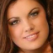

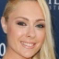
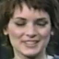

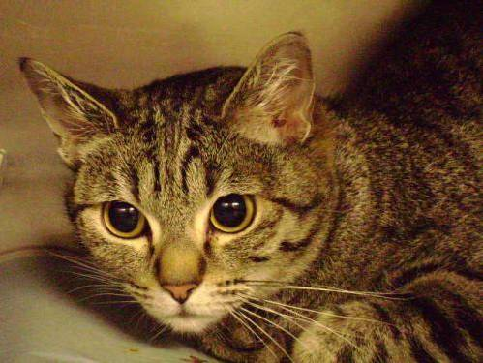
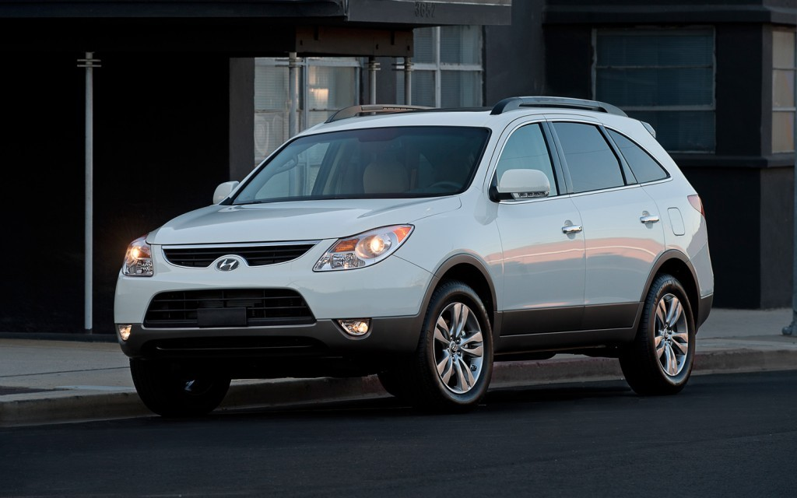
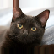
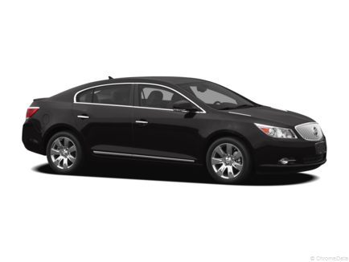
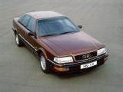
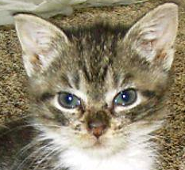
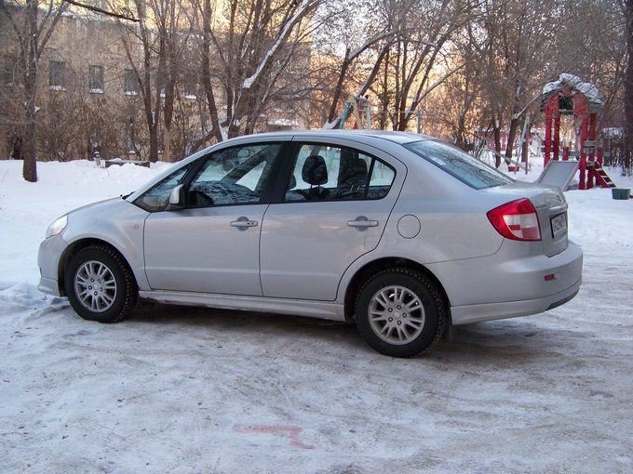

Problem
How to learn the 3D shape prior?
Supervised
Require massive 3D data → hard to acquire
Unsupervised
Observe 2D images of the same category
Notes:
Problem

Slide 5
Previous approach – LeSym*
Only symmetric objects !!!
* S. Wu, C. Rupprecht, and A. Vedaldi. “Unsupervised learning of probably symmetric deformable 3d objects from images in the wild”. In CVPR 2020.
Notes:
Problem

Slide 6
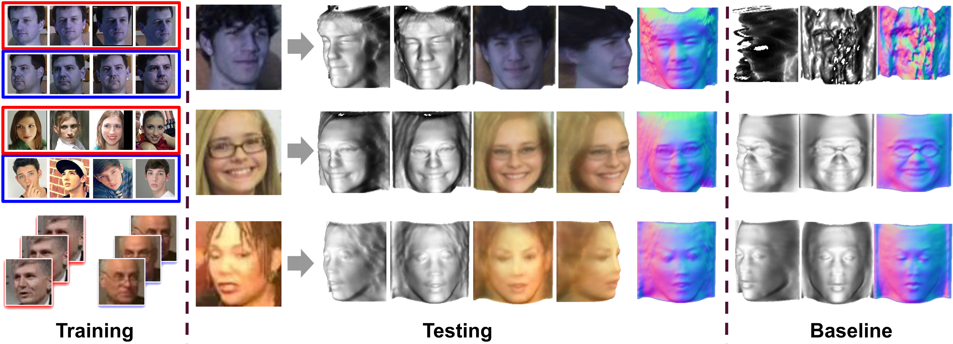
Our solution?
Multi-view
Many datasets have multiple images for each object instance
Cover symmetric objects
Shape consistency
Collection
Video
Notes:
Proposed system

Slide 7
LeMul
Training
Testing
Multi-view
Collection
Video
Learning from Multi-Image Datasets - LeMul
Notes:
Proposed system

Slide 8
LeMul System

Slide 9
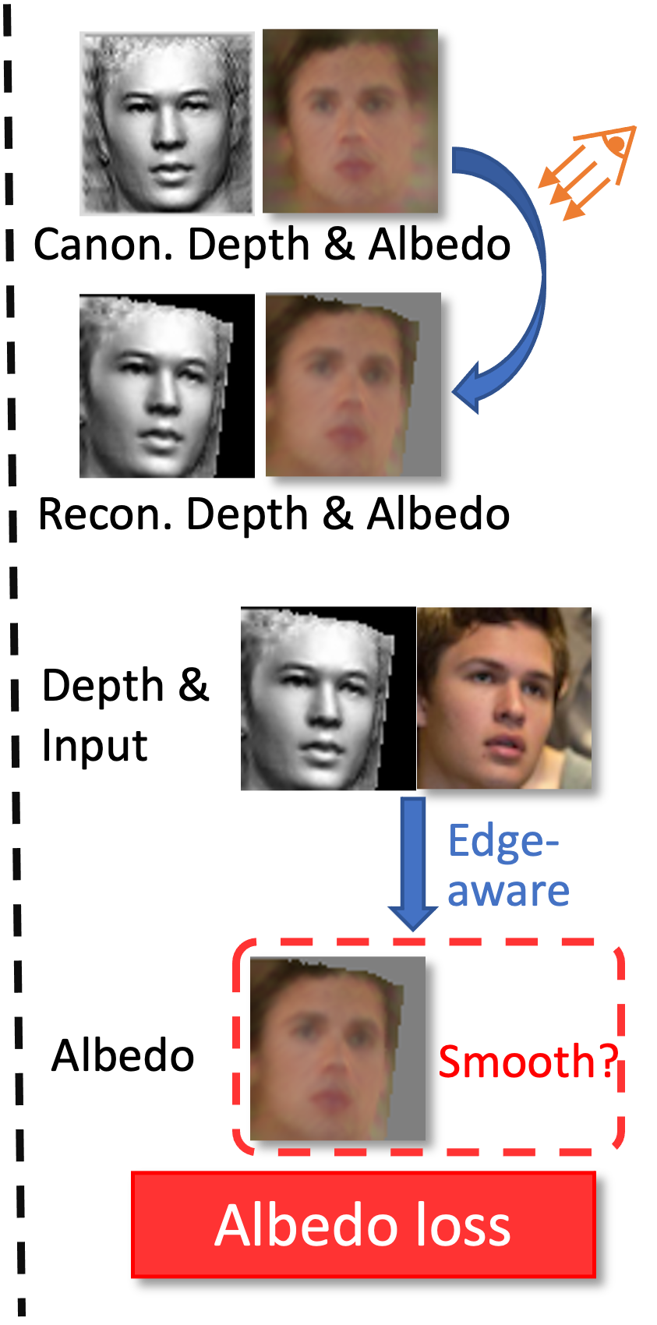

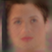
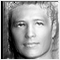

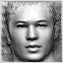
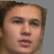
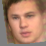
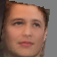
LeMul system
View 1
Light 1
Canon. Albedo1
Canon. Depth1
Input 1
Decomposing Network
Recon. image 1
Input 1
Reconstruction loss
Canon. Albedo2
Canon. Depth2
View 2
Light 2
Input 2
Recon. image 2
Input 2
Input 1
Cross-view image 1
Cross-view image 2
Input 2
Cross-view consistency loss
*Note that we omit the confidence maps in this figure for simplicity
Notes:
Detail

Slide 10
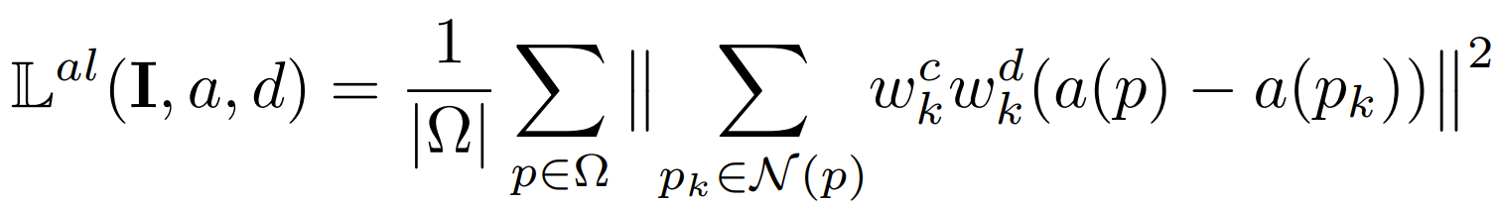
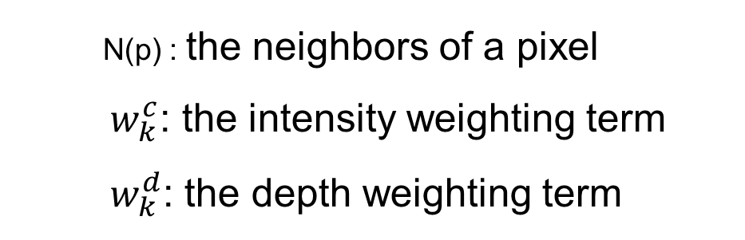
LeMul system
Where:
N(p) : the neighbors of a pixel $w_{k}^{c}$: the intensity weighting term
${ w}_{k}^{d}$: the depth weighting term
Notes:
Explain albedo loss

Slide 11
Results

Slide 12
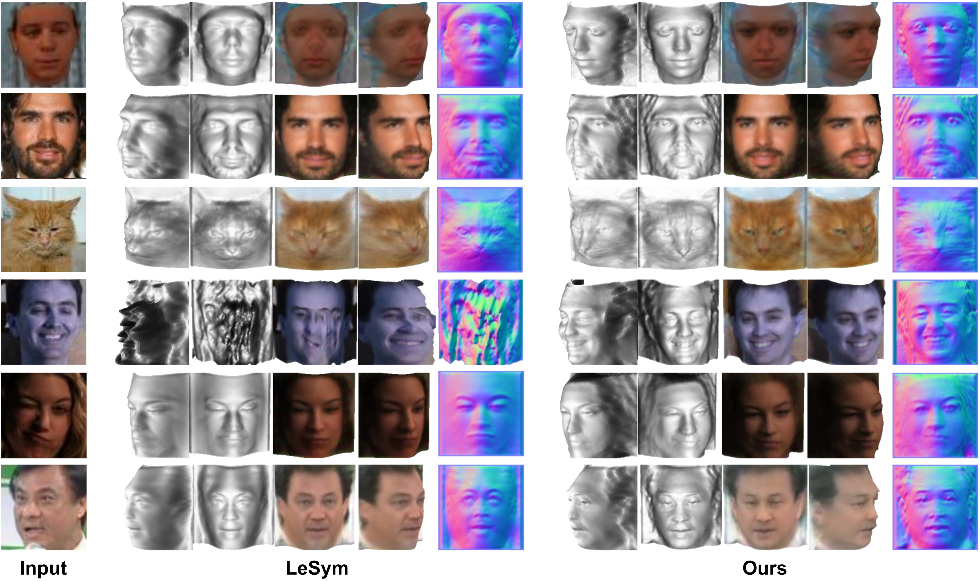
Qualitative results
Input
LeSym
Ours
BFM
CelebA
CatFaces
MultiPIE
CASIA
YTF
Notes:
Show time

Slide 13
Qualitative results
Input
LeSym
Ours
BFM
CelebA
CatFaces
single-image, symmetric objects
Notes:
Show time

Slide 14
Qualitative results
Input
LeSym
Ours
BFM
CelebA
CatFaces
MultiPIE
multi-view dataset
Notes:
Show time

Slide 15
Qualitative results
Input
LeSym
Ours
BFM
CelebA
image collection dataset
CatFaces
MultiPIE
CASIA
Notes:
Show time

Slide 16
Qualitative results
Input
LeSym
Ours
BFM
CelebA
video dataset
CatFaces
MultiPIE
CASIA
YTF
Notes:
Show time

Slide 17
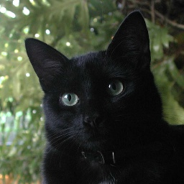
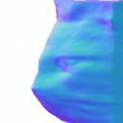
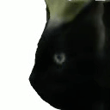
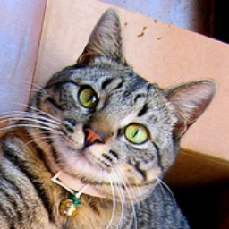
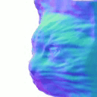
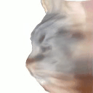
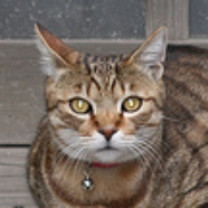
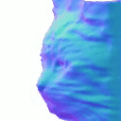
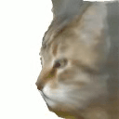
Cat Faces (single + symmetric)
LeMul
Notes:
Show time

Slide 18
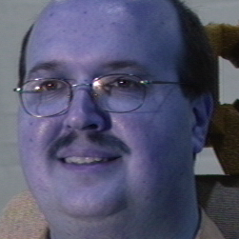
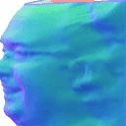
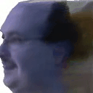
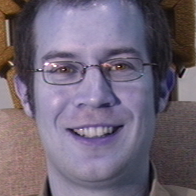
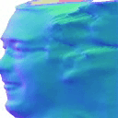
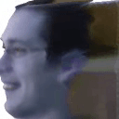
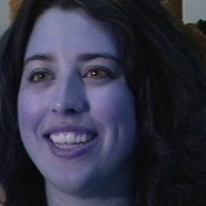
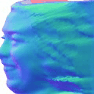
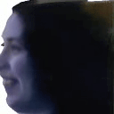
Multi-PIE (multi-view)
LeMul
Notes:
Show time

Slide 19
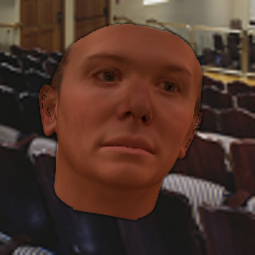
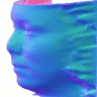
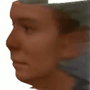
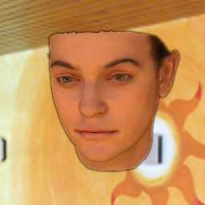
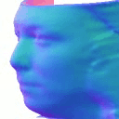
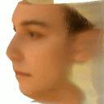
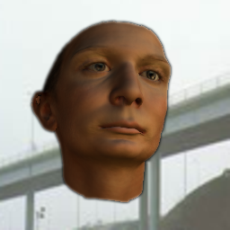
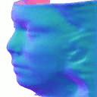

LeMul
Notes:
Show time

Slide 20









CASIA-WebFace (image collection)
LeMul
Notes:
Show time

Slide 21

CASIA-WebFace (image collection)
In-the-wild
Input
LeSym (CelebA)
LeMul (CASIA)
Notes:
Show time

Slide 22

Quantitative results
Better surface reconstruction on BFM
Better voted via user surveys on all datasets
BFM results comparison with baselines.
Notes:
Show time

Slide 23

Quantitative results
Better surface reconstruction on BFM
Better voted via user surveys on all datasets
LeMul vs. LeSym (SIDE)
BFM results comparison with baselines.
Notes:
Show time

Slide 24
THANK YOU
https://github.com/VinAIResearch/LeMul

